Slide 1
Scale Up with Python
Uncoiling Python's Basics
Toby Lewis and Kieran Baker

Slide 2


Outline
What is programming?
Where does Python fit in?
How do we use it on our computer?
20
mins
What is Python?
Notebooks
Types
Variables & Names
Packages
Conditional statements
Loops
30
mins
Let’s get programming: Python Specifics
BREAK
5-10 mins
30
mins
How do we use Python at Acin
What can we use this for at Acin
Mini Task
Let’s really get programming…

Slide 3
What is Python?

Slide 4
What is Programming?

Slide 5



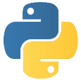
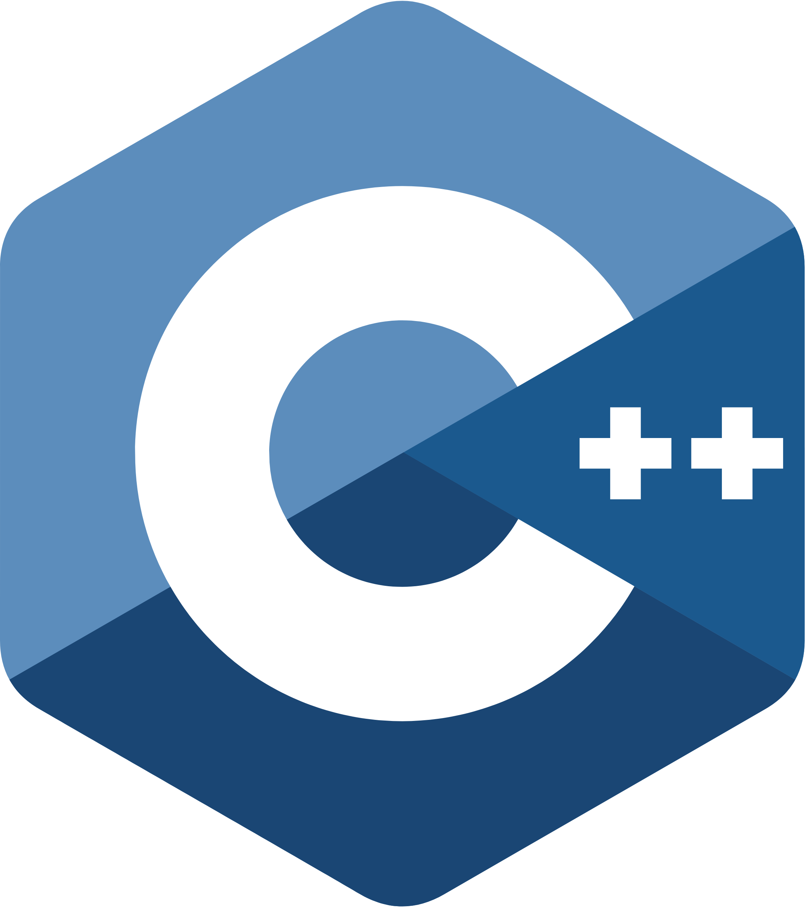
Drawing Distinctions
Computer
Machine that takes inputs and calculates outputs
Hardware – runs ‘computations’
OS – used to manage software and user interaction with the hardware
Information stored and processed as binary
Program
An OS contains several programs.
Anything from a full-fledged application to single script.
Set of operations/instructions bundled into a useful package.
Potentially built using multiple programming languages.
Programming Language
A tool to provide instructions to the computer hardware for execution.
Human readable version of binary code.
Each has strengths and weaknesses – typically task specific
‘Paradigms’ are used to describe language properties.

Slide 6

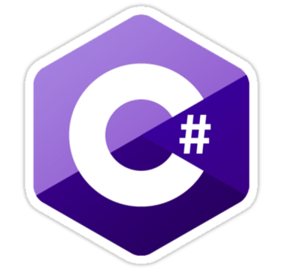









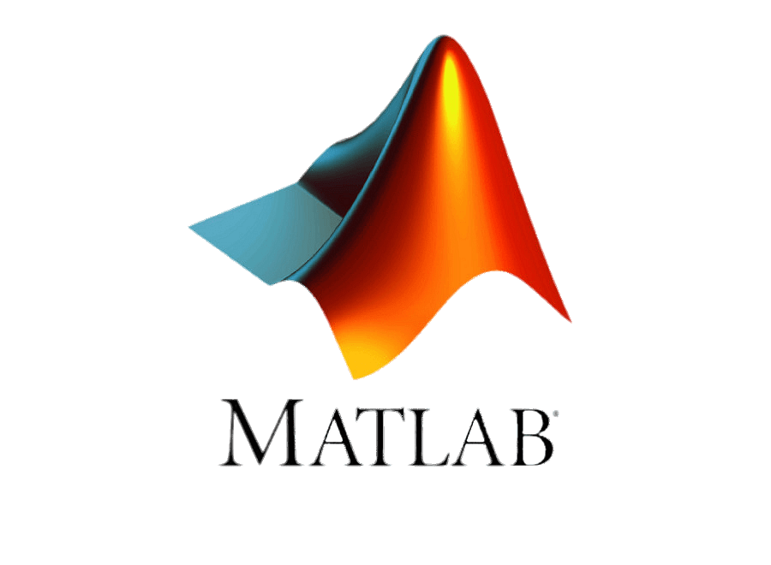
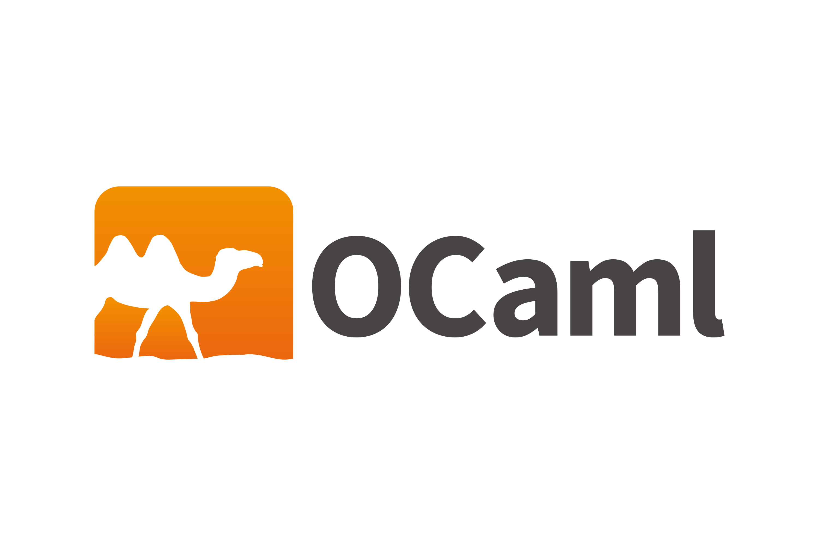




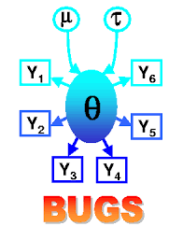



For what exactly?
General Purpose
Domain Specific
Data Management
Document
Shell
Numerical Computation
Microsoft Apps
Statistical Modelling
Music Synthesis
Notes:
C, C++, C#
Java, Javascript
OCamel
Julia
Ruby
Python
Data Management: SQL (and variants), MQL
Document: HTML, LaTex, Markdown
Shell: Bash, ZShell
Numerical Computation: R, MATLAB, SAS
Microsoft Applications: VBA
Statistical Modelling: Stan, Bugs
Music Synthesis: CSound

Slide 7


Levelling Up
High level vs low level programming languages
High Level Programming Languages:
User-oriented
Slower processing
Transparent syntax
Low Level Programming Languages:
Machine-oriented
Fast runtime
Obtuse syntax
01000001 01100011
01101001 01101110

Slide 8
Where does Python fit in?

Slide 9




Python
A Brief History
2008: First Pandas release
2000: Python v2 released
1989: First Python implementation lead by creator Guido Van Rossum at Centrum Wiskunde & Informatica (CWI)
2020: Python v2 depreciated
1990
2000
2010
2020
1991: First iteration published
2008: Python v3 (current-ish) released
2021: Python tops TIOBE index of language programming popularity
2014: Jupyter notebooks first released under ‘Project Jupyter’
1972: C developed at Bell Labratories

Slide 10

Python
But, why?
Easy To Use
High level
English-like syntax
Built-in formatting
Free and open source
General purpose
Multi-Paradigm
Procedural: can explicitly write process as set of explicit step-by-step instructions
Functional: can explicitly write process as series of reusable functions and execute appropriately
Object Oriented: code structured around abstract ‘objects’ that contain data and associated methods
Notes:
Think of good multi-paradigm analogy – cleaning robot

Slide 11

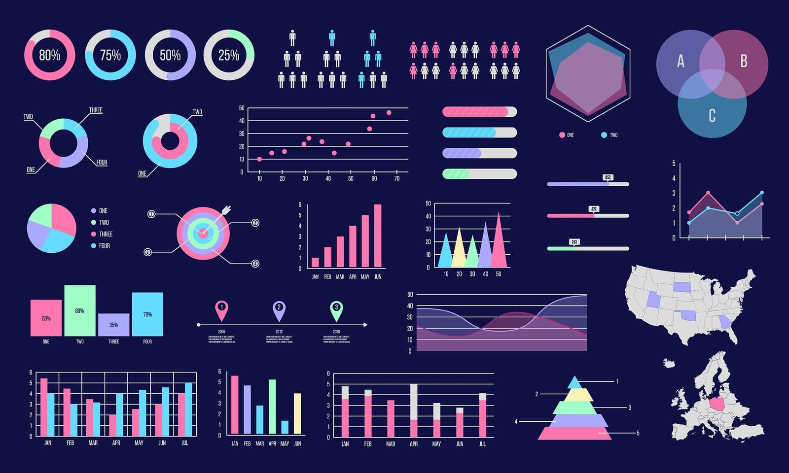





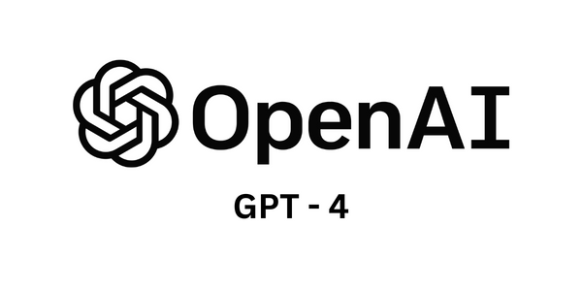

Python
Notable use cases
Data Analysis and Visualization
App Development
Machine Learning and NLP
Game Development

Slide 12
Python
Notable use cases

Slide 13
Python
Notable use cases
Data Analysis and Visualization
App Development
Machine Learning and NLP
Game Development
Notes:
Note, DC (and nascent search part of Acin app) relies on some Python underneath

Slide 14
How can we start using it?

Slide 15
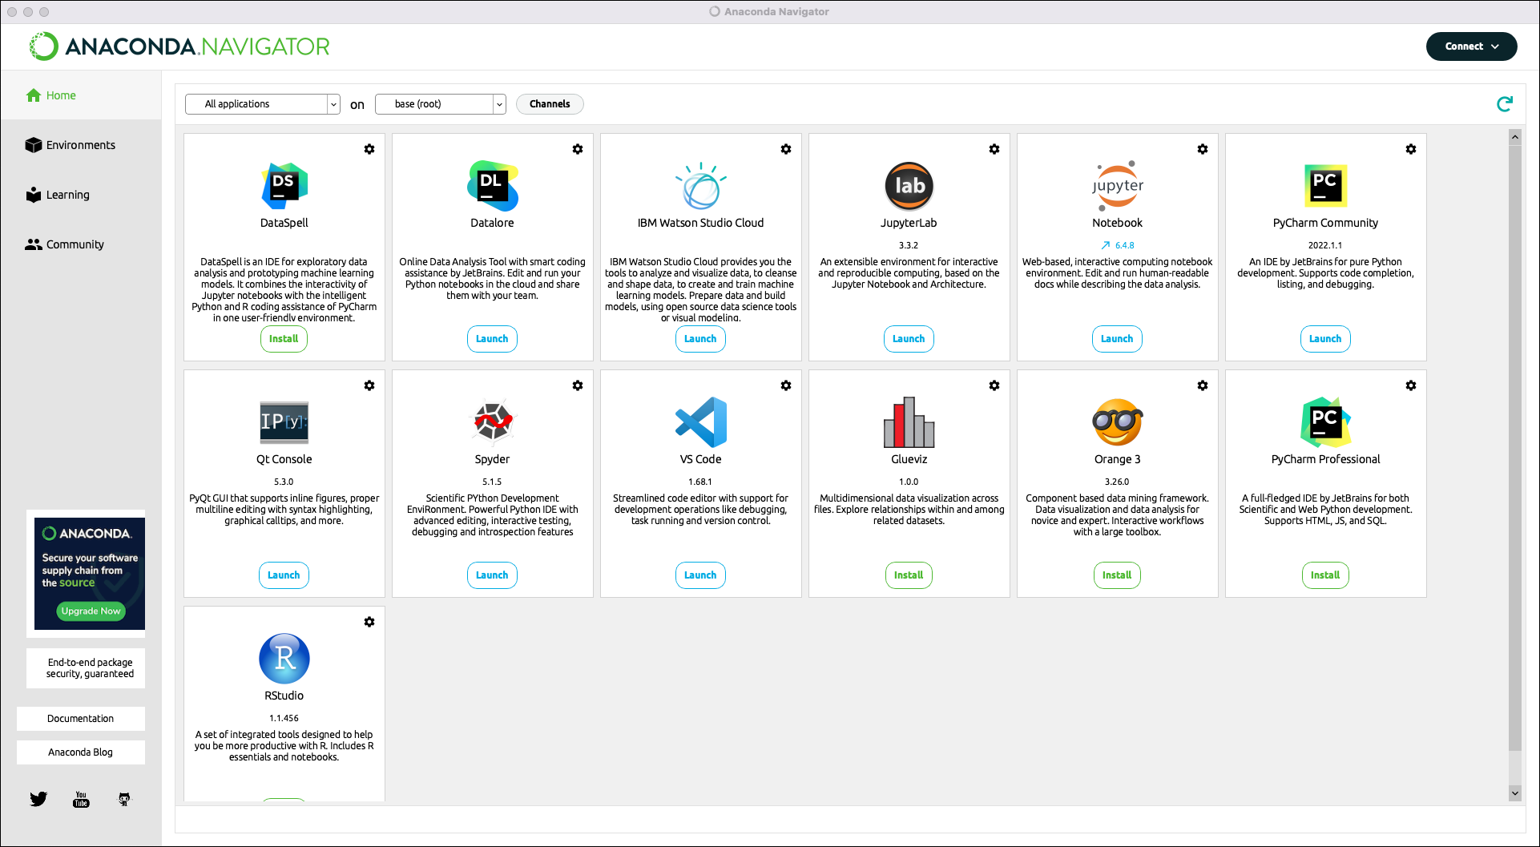
Python
Where is it?
Mac
Installed naively but can also use with Homebrew
Easiest to install new versions via Terminal
Can manage packages within Anaconda/Homebrew and/or others
Windows
User install required
Can update version via Windows Installer or Command Line
Can manage packages within Anaconda and/or others

Slide 16
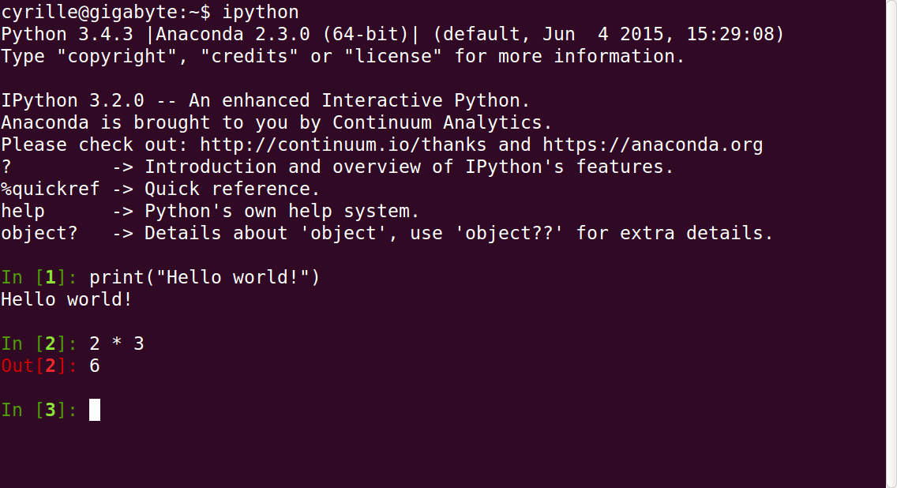
Python
How can I use it? - Terminal
Notes:
Lot’s of different IDEs:
- terminal (ipython or run)
--flexible, means macro->terminal->run .py
- pycharm
- plugins - externally (excel graphing)
- Notebooks
You don’t have to worry about all of that…we’ve done it for you

Slide 17
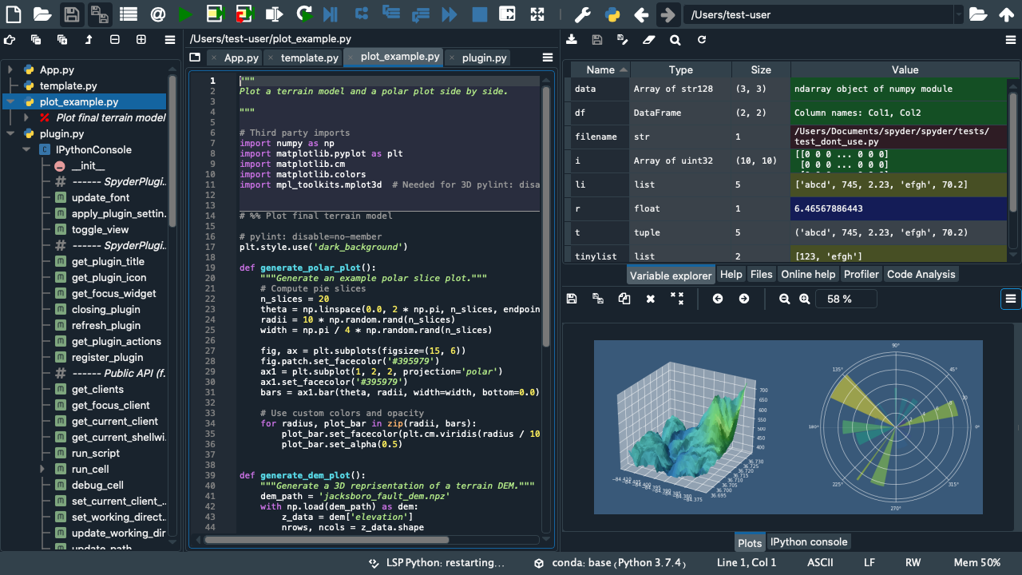
Python
How can I use it? – Other Anaconda IDEs
Notes:
Lot’s of different IDEs:
- terminal (ipython or run)
--flexible, means macro->terminal->run .py
- pycharm
- plugins - externally (excel graphing)
- Notebooks
You don’t have to worry about all of that…we’ve done it for you

Slide 18
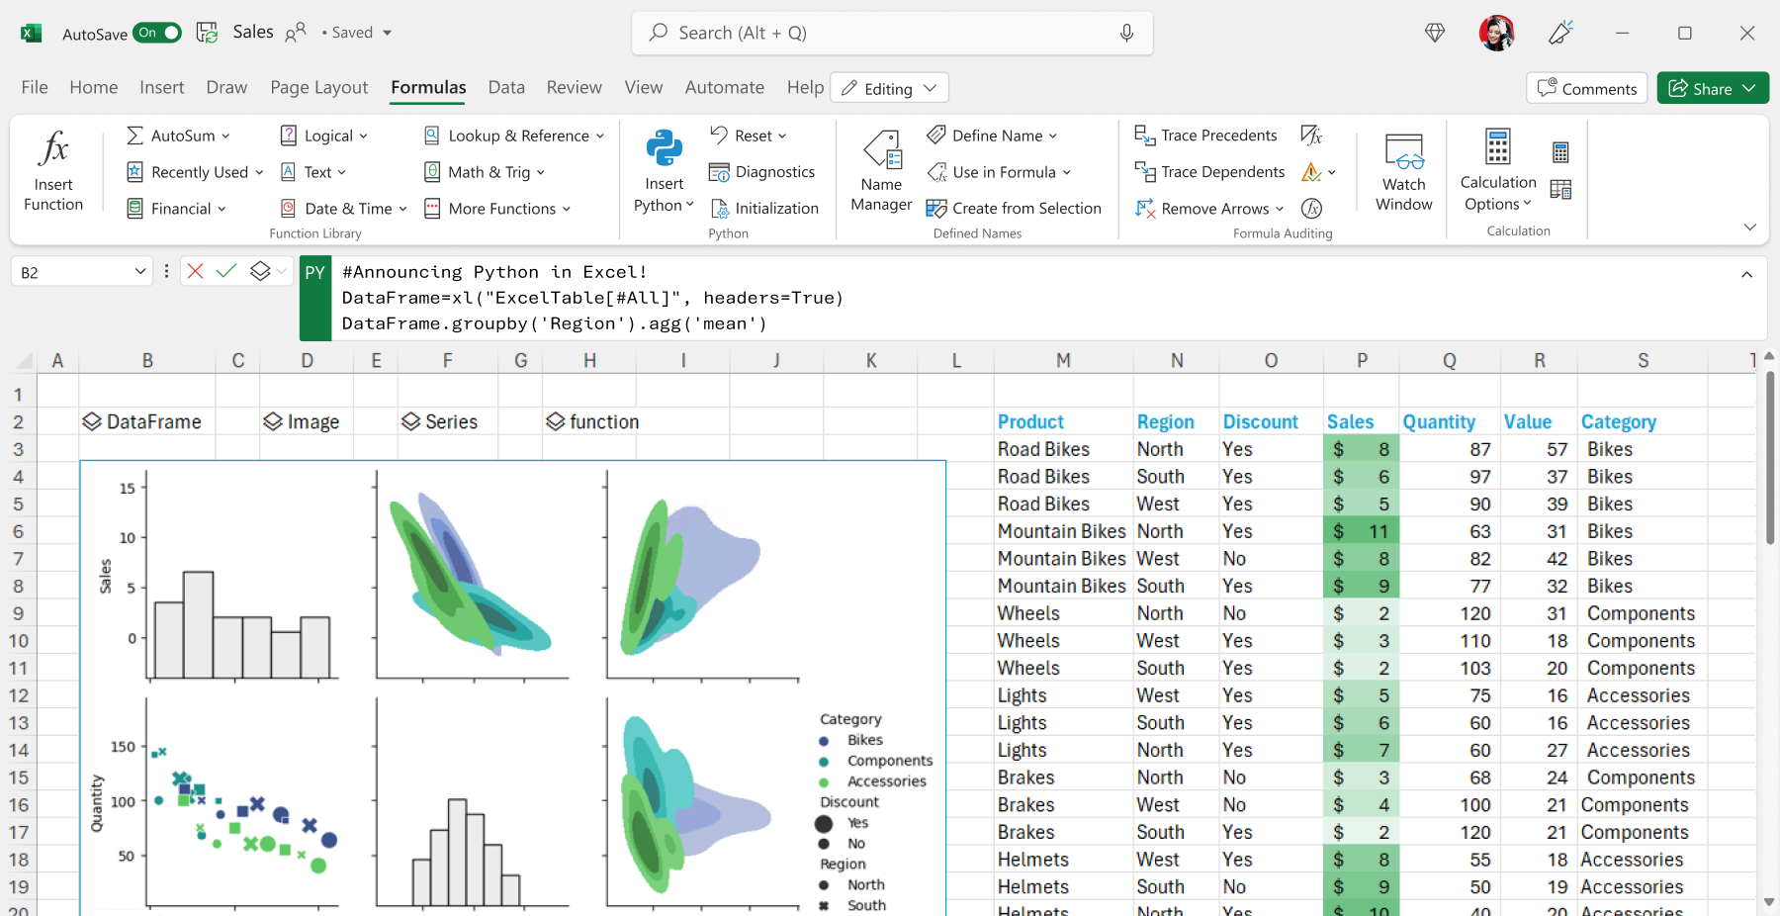
Python
How can I use it? - App Integrations
Notes:
Lot’s of different IDEs:
- terminal (ipython or run)
--flexible, means macro->terminal->run .py
- pycharm
- plugins - externally (excel graphing)
- Notebooks
You don’t have to worry about all of that…we’ve done it for you

Slide 19
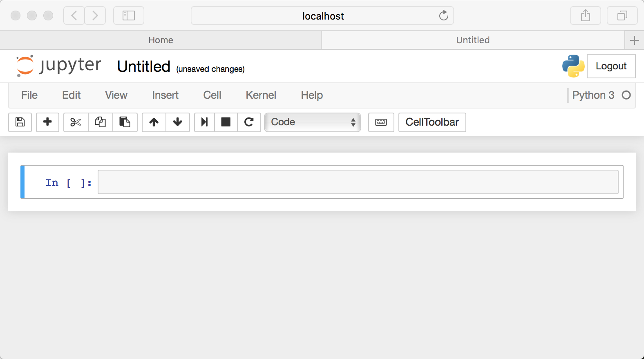
Python
How can I use it? - Jupyter Notebooks
Notes:
Lot’s of different IDEs:
- terminal (ipython or run)
--flexible, means macro->terminal->run .py
- pycharm
- plugins - externally (excel graphing)
- Notebooks
You don’t have to worry about all of that…we’ve done it for you

Slide 20

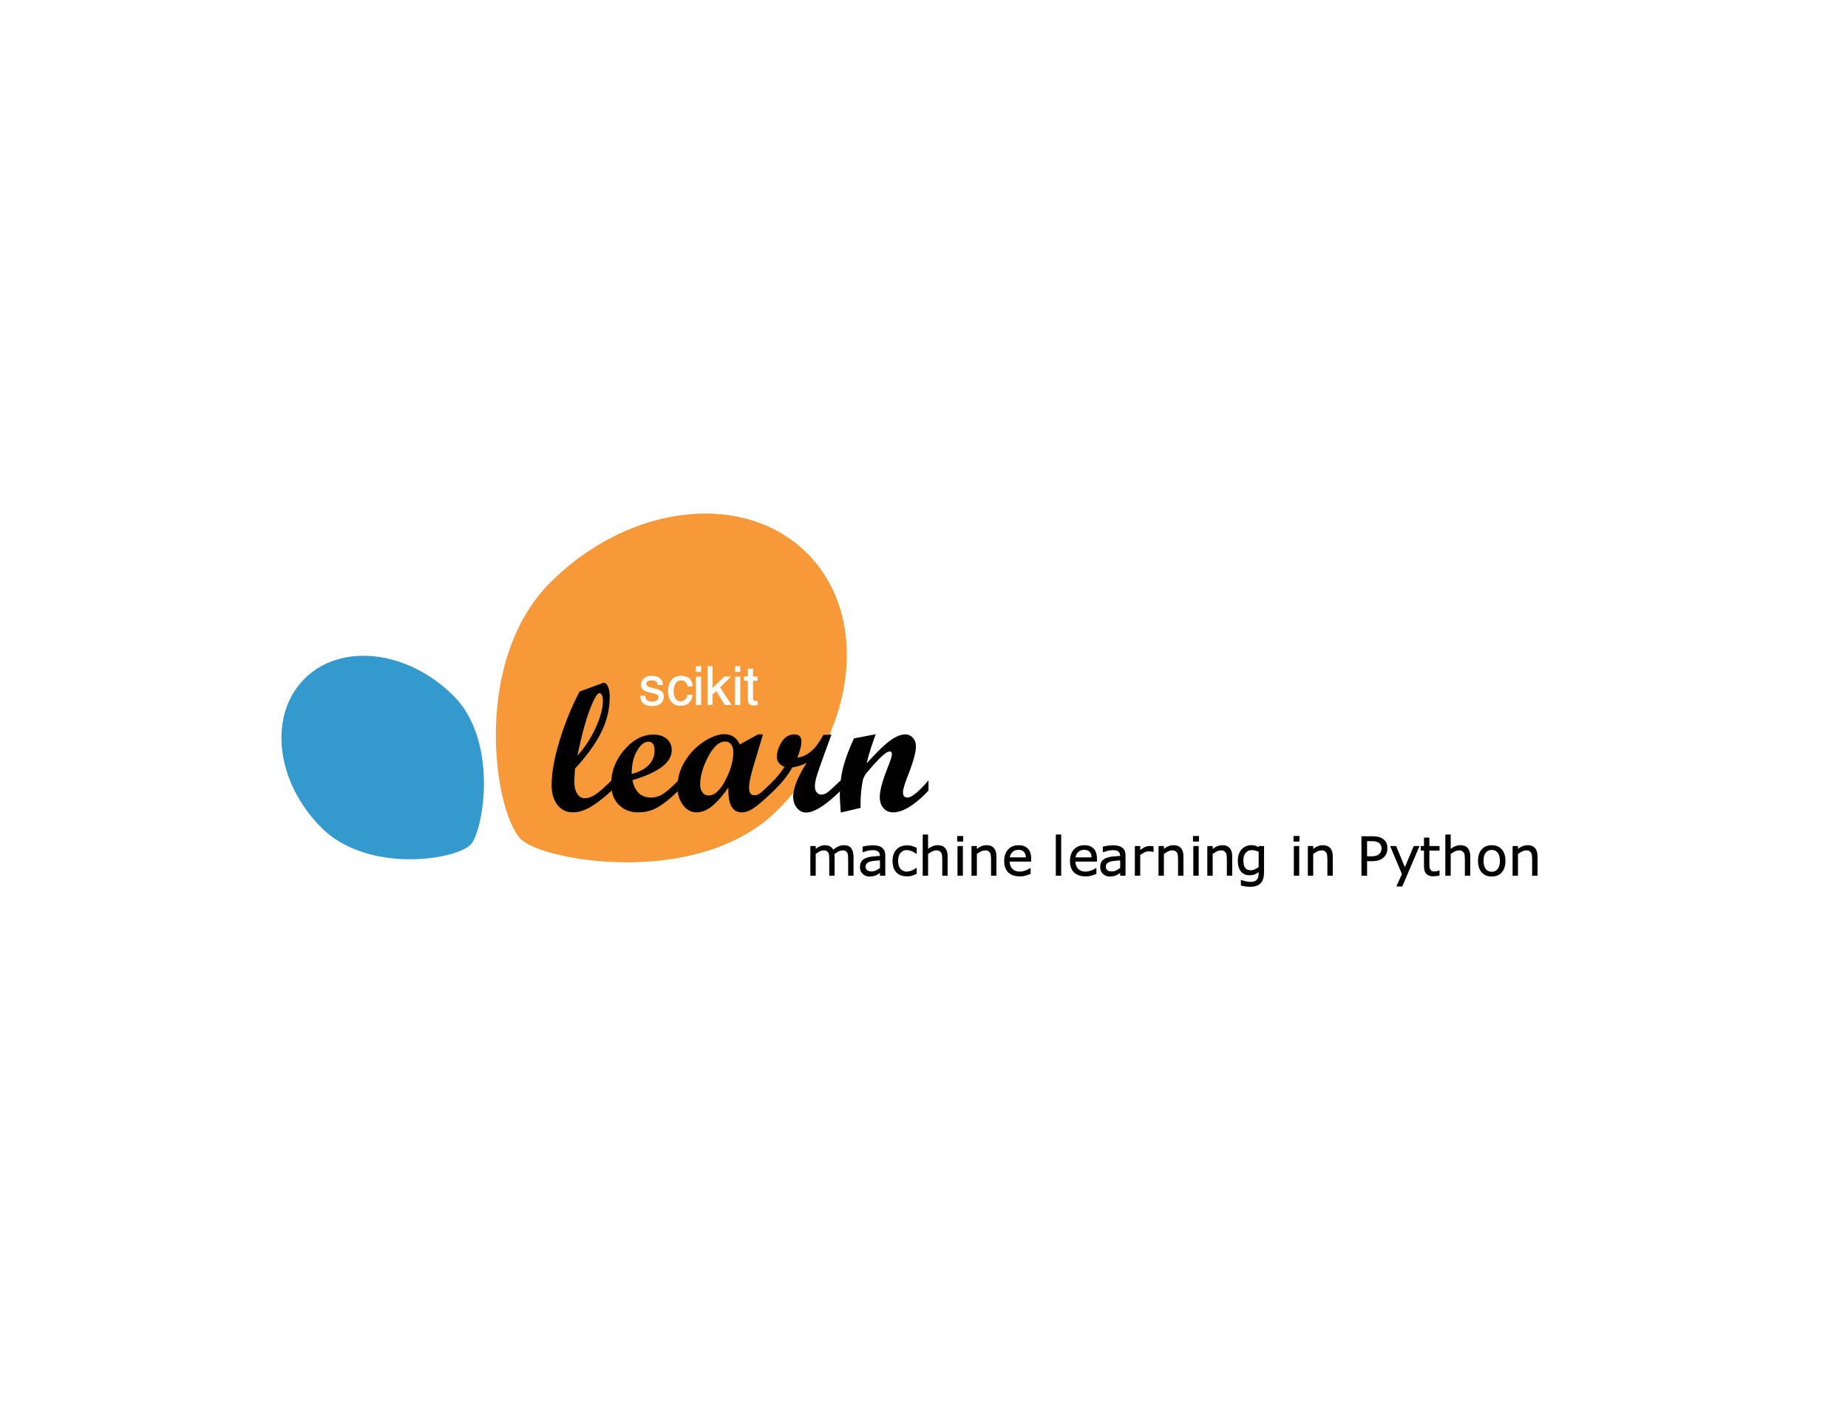
Python
Versions? Packages?
Integrated Development Environment (IDE)
Virtual Environment
Python Version
Packages
Notes:
How should be used version->environment->anaconda->jupyter

Slide 21
Questions?

Slide 22
Let’s get coding!

Slide 23
LINK

Slide 24
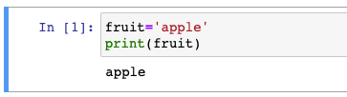
Overview
Basic Data Structures
Variable
Name
Data
Types
String
List
Dictionary
Integer
…

Slide 25
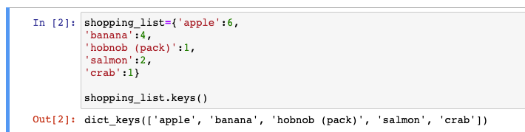
Overview
Basic Data Structures
Variable
Name
Data
Types
String
List
Dictionary
Integer
Method

Slide 26
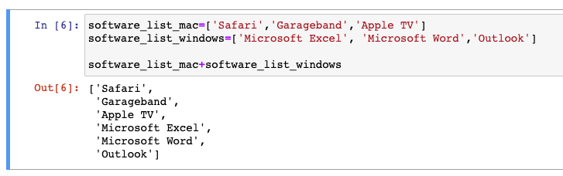
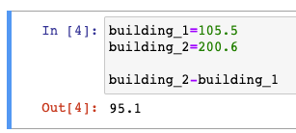
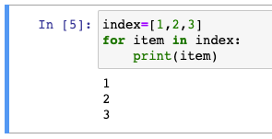
Overview
Basic Data Structures
Combine
Variable
Compare
Variable
Update
Variable
Methods
Variable
Loops
Variable

Slide 27
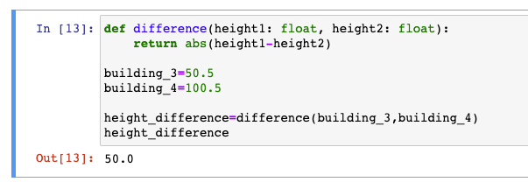
Overview
Basic Data Structures
Function
Variable 1
Combine
Compare
Update
Loops
…
Variable 2

Slide 28
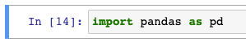
Overview
Basic Data Structures
Package/Library
Function
Custom Type
Variable
Name
Data
Method
…
Function
Variable
…
…

Slide 29
Let’s take a break

Slide 30
What about at Acin?

Slide 31

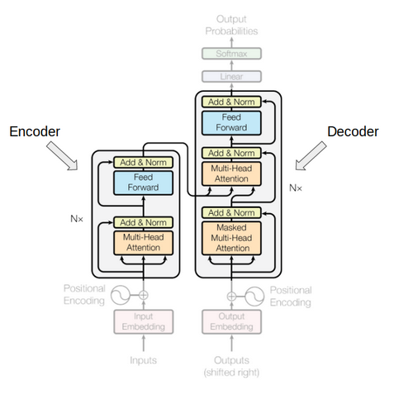

Python @ Acin Now
Use cases
Ad-Hoc Data Analysis and Visualization
Metrics Development
Productionize Metrics and Models
NLP
Notes:
NLP
- Access/DC models
- Ad-hoc analysis
- Increasingly integrating LLMs into workflow -> restructure controls/help better link up network
- DataOps tool
Metrics:
- Business Line Reason Code
- Control Impact Rating
- North Star

Slide 32


Python @ Acin – For the Future
What’s next
Towards
“Automated” Networking
Acin Chatbot
Control Quantification
Notes:
Embracing LLMs
- Improved Search
- Chatbot
- Report generation
- Reformatting controls:
- Improved matching
- Index build

Slide 33
Python @ Acin – For the Future
What’s next
Embracing Large Language Models
Notes:
Embracing LLMs
- Improved Search
- Chatbot
- Report generation
- Reformatting controls:
- Improved matching
- Index build

Slide 34
Alright, let’s really get coding!

Slide 35
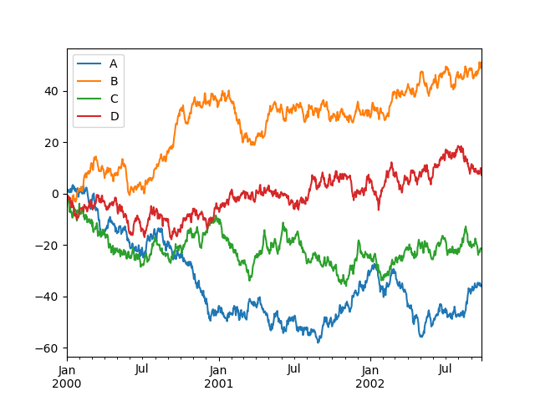
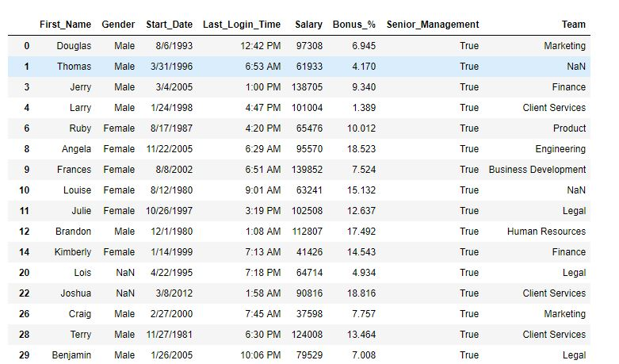
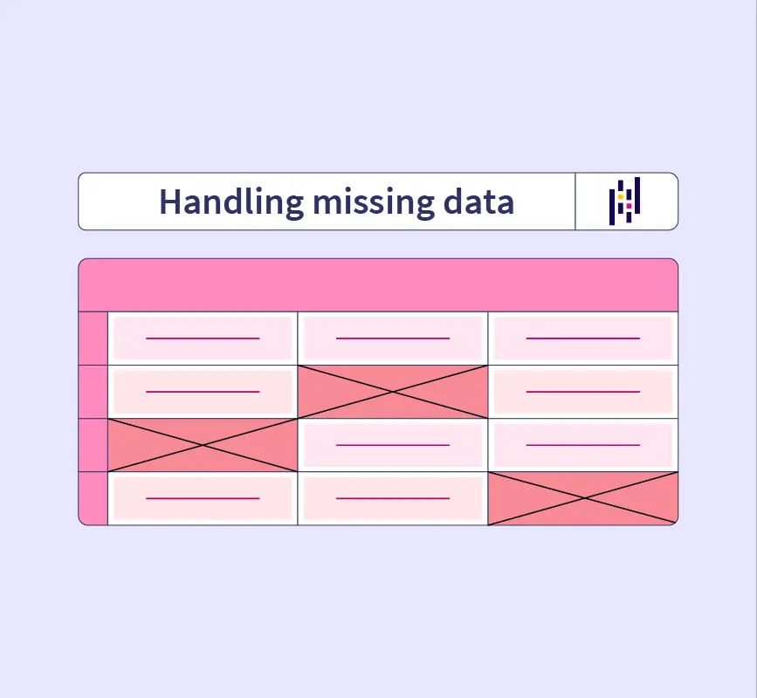
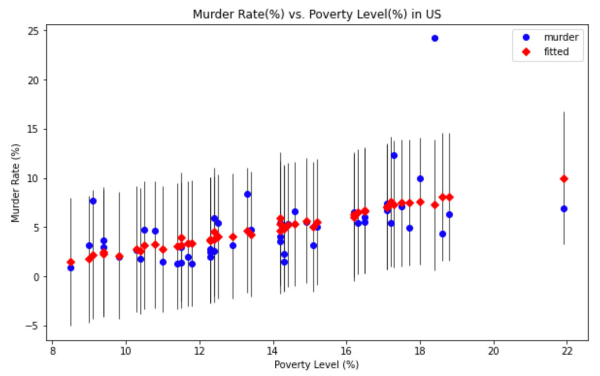
Mini-Tasks
Plotting with Pandas and Matplotlib
Data Querying
Statistical Modelling (Group Activity)
Handling Missing Data

Slide 36
LINK

Slide 37
Questions?

Slide 38
Thank you.
Email Us
For follow-up enquiries: toby.lewis@acin.com
Kieran.baker@acin.com
Call Us Speak with us: 0203 728 8585
Find Us (At least twice a month) Acin, Level 1, Equitable House 47 King William Street, London, EC4R 9AF

